Slide 1
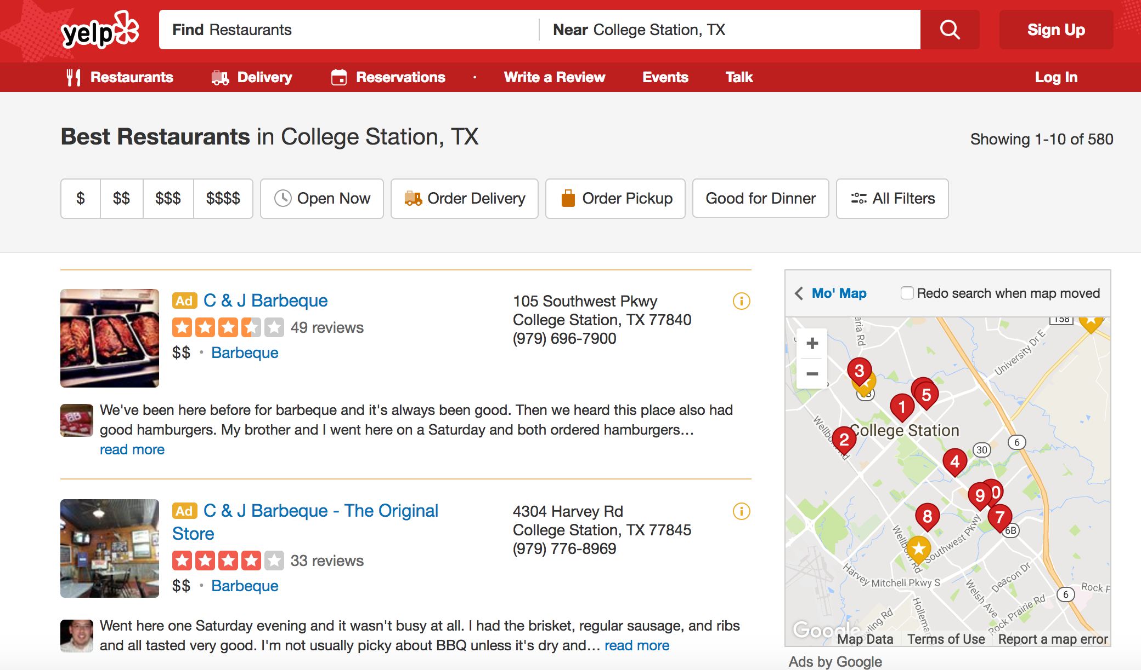

Slide 2

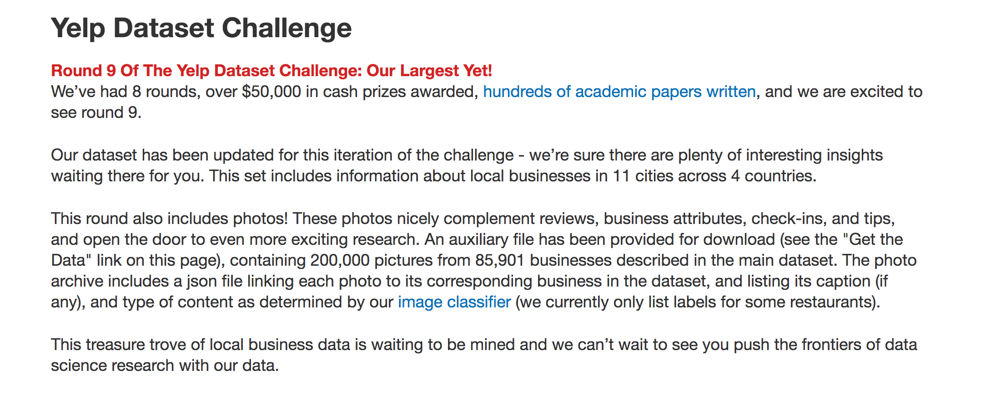

Slide 3
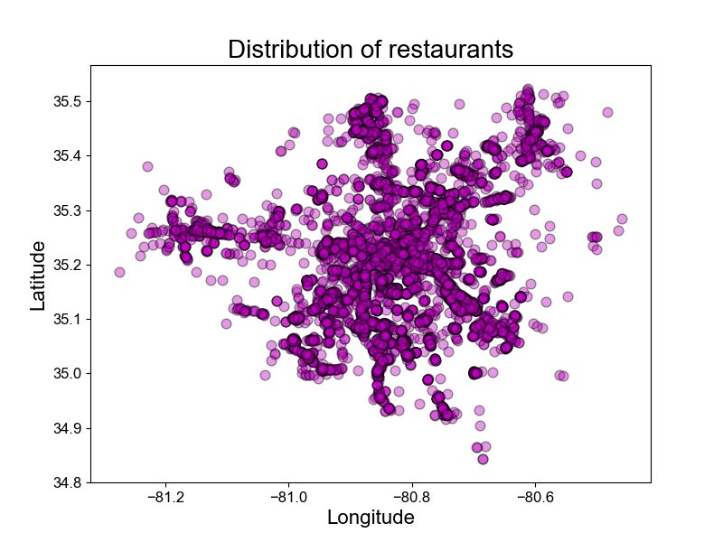
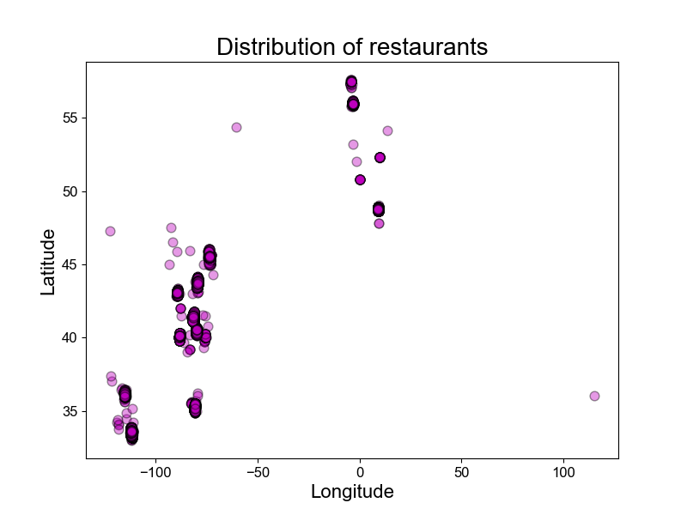

Slide 4
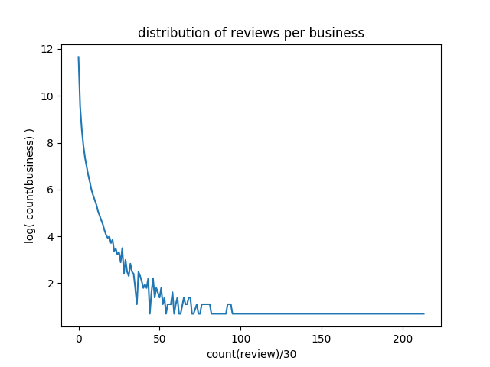
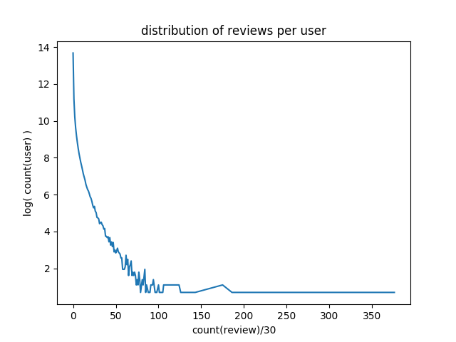

Slide 5
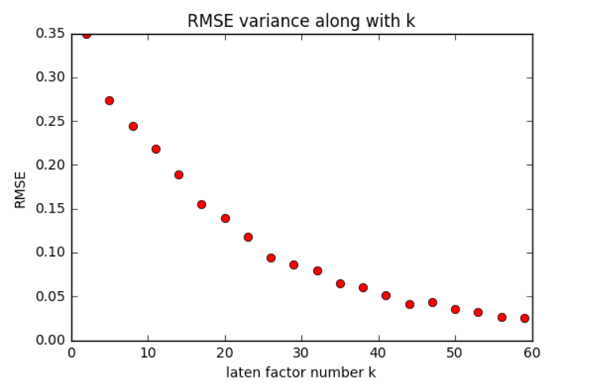

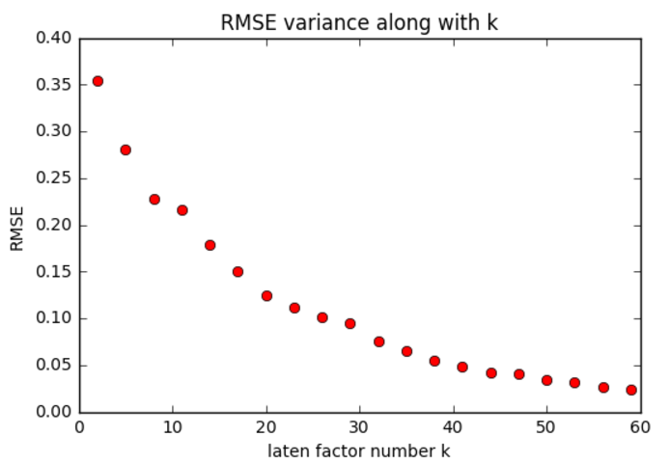

Basic MF
Basic MF uses SVD method to deposit the rating matrix into U*V
Predict unknown rating by U*V
The latent factor number K chosen 30
(1)
(2)

Slide 6
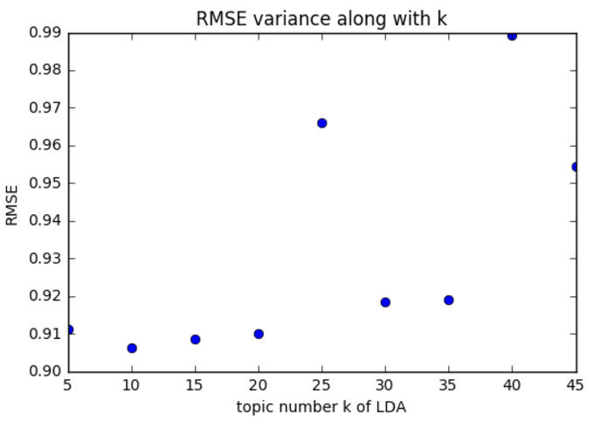
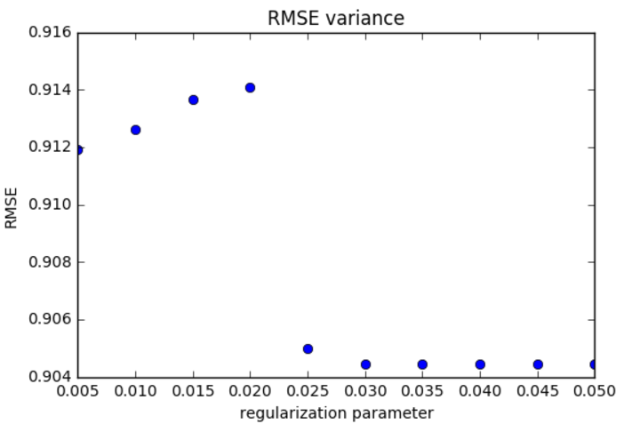

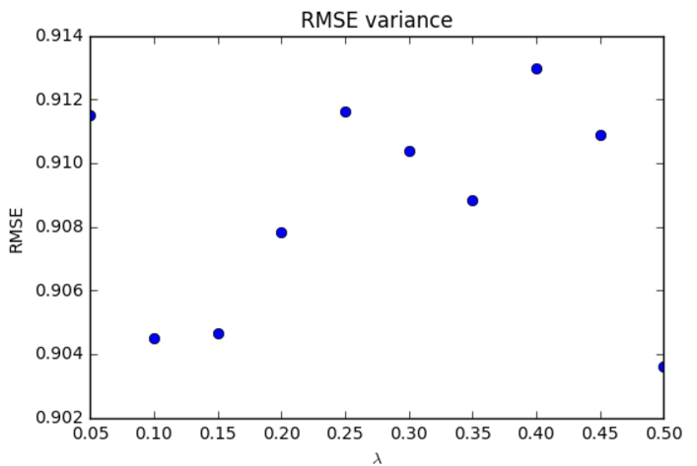
Topic MF in the paper
To get the topic distribution of reviews and words, LDA (Latent Dirichlet Allocation) is used
The model is trained as:
Result after parameter adjust, 0.907157138867
(3)

Slide 7
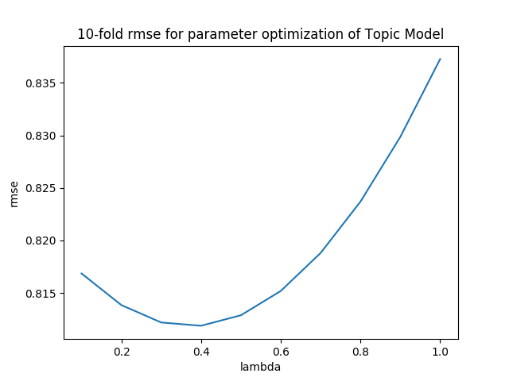
Topic MF by ourselves
Pre-processed all reviews
For each business, we grouped all its reviews in training data as bag-of-words, and then use the LDA library to calculate the topic distribution for each business.
For each user, we calculate his/her topic rating using linear regression based on his/her real-ratings in training data subtract Ubb.

Slide 8

Social MF in Paper
Users are likely to ask for suggestions from their local friends
Users tend to seek suggestions from those with high reputations
Combined the two indication, social MF is modeled as:
Finally, RMSE is 1.04159139513

Slide 9
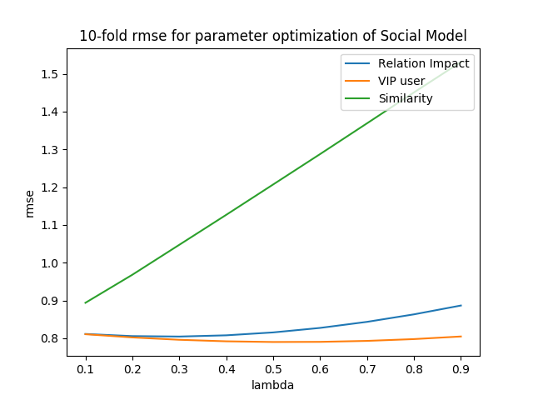
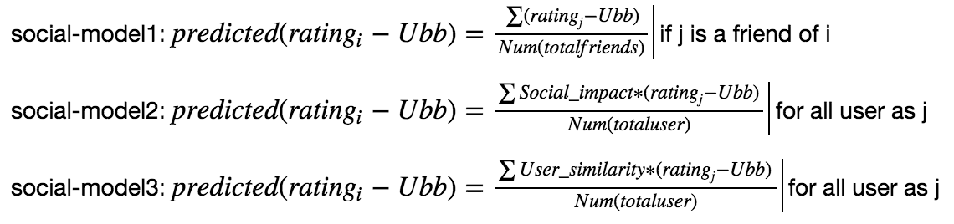
Our Social Model
Relation
VIP User
Similarity

Slide 10
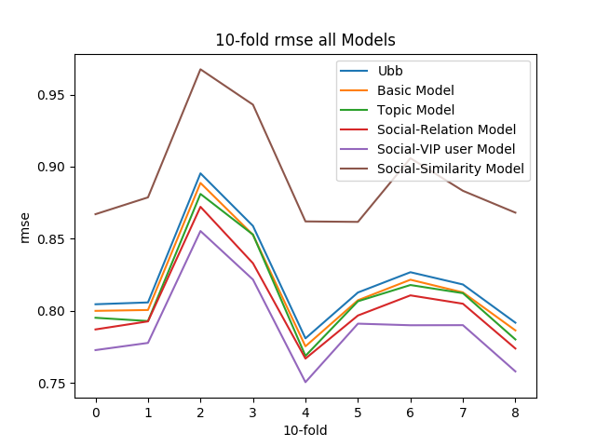
Result

